Slide 1
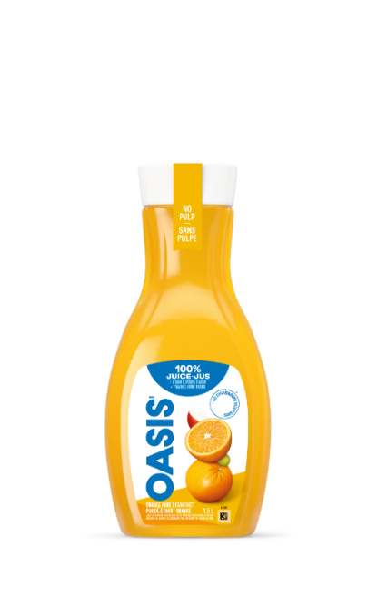
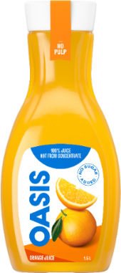
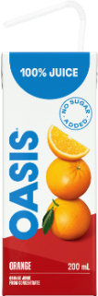
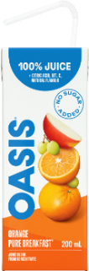

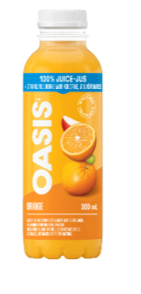


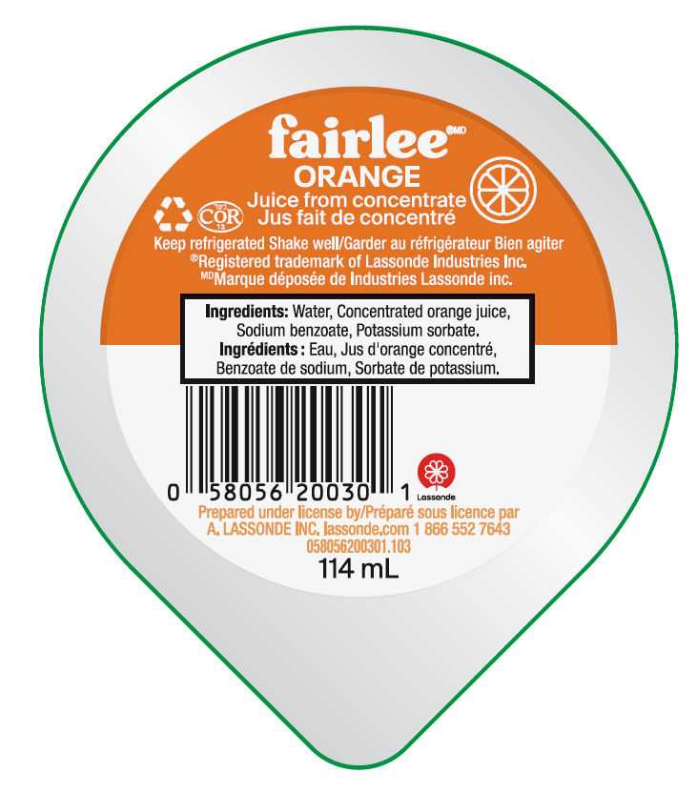
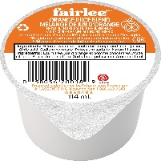
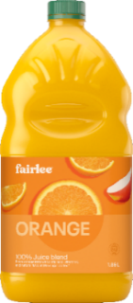
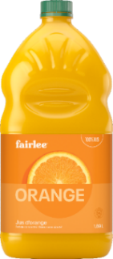
Lassonde Foodservice Orange Juice Changes
Effective Dec 2023
Effective Feb 2024
New Orange Pure Breakfast NFC No Pulp as an economical option Feb 2024
30 x 200ml
24 x 300ml
8 x 1.5L
Oasis Orange Pure Breakfast
Sysco SUPC Code#4610152
GFS Code #1311424
Oasis Orange Blend
Sysco SUPC Code#
GFS Code#
Oasis NFC Orange Juice No Pulp
Sysco SUPC Code#5526171
GFS Code#1411548
Oasis NFC Orange Pure Breakfast No Pulp
Sysco SUPC Code#
GFS Code#
The OJ NFC No Pulp will still be available to purchase
Effective Mid March 2024
Effective January 2024
96 x 114ml
Fairlee Orange Blend
Sysco SUPC Code#
GFS Code#
6 x 1.89L
Fairlee Orange Blend
Sysco SUPC Code# 5829708
GFS Code#1459122

